Slide 1

Database Systems & Database Security
By: Shanysse alexander
Intro to db systems 226-101
March 17, 2023

Slide 2
Introduction
Database Systems are important because they allow users to have an organized system for their data. While also giving the user fast access to their specific data creating an efficient way of updating and deleting from their database.
Database Security provides protection for a database in order to aid against cyberattacks. This is important because databases contain sensitive information for users that could be detrimental if they are released.

Slide 3

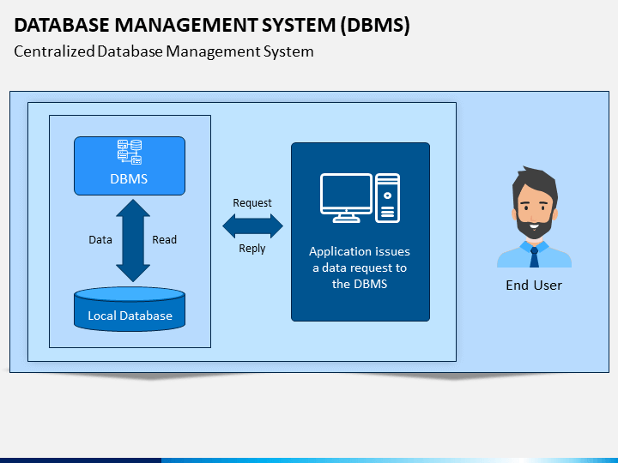
Database Management System
Definition-a collection of programs used to interact with and manage data in the database.

Slide 4
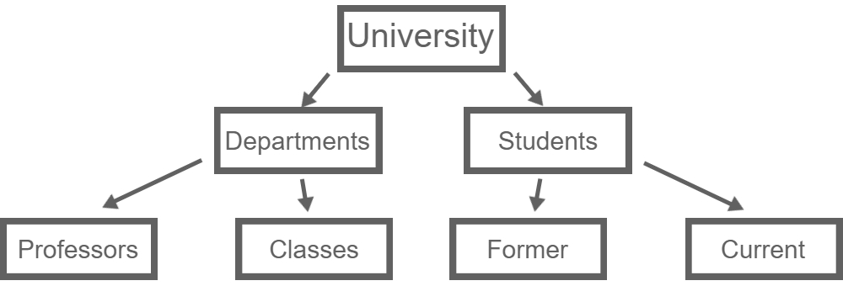

Relational Database & Hierarchical
Relational Database
Definition- A software program in which data is organized as a collection of tables, and relationships between tables are formed through a common field.
Ex: Oracle Database, IBM DB2
Hierarchical
In a hierarchical model, data is shown as a collection of tables, or segments that form a hierarchical relation.
IBM’s IMS

Slide 5
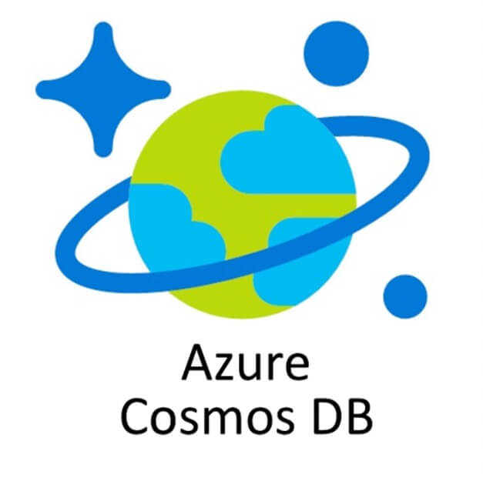
NoSQL Database
NoSQL databases or “nonrelational databases” show that they can handle huge volumes of rapidly changing, unstructured data in different ways than a relational (SQL) database with rows and tables.

Slide 6
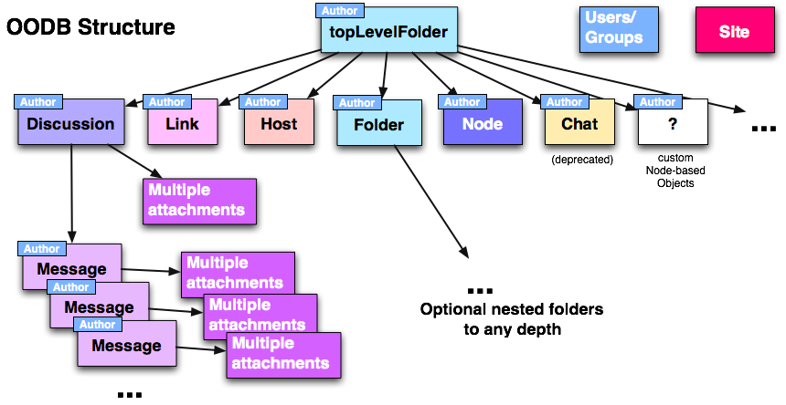
Object-Based & Object-Oriented
Object-Based
each entity is treated as an object and represented in a table
Object-Oriented
allows direct access to data from an object-oriented programming language using the language’s native type system

Slide 7
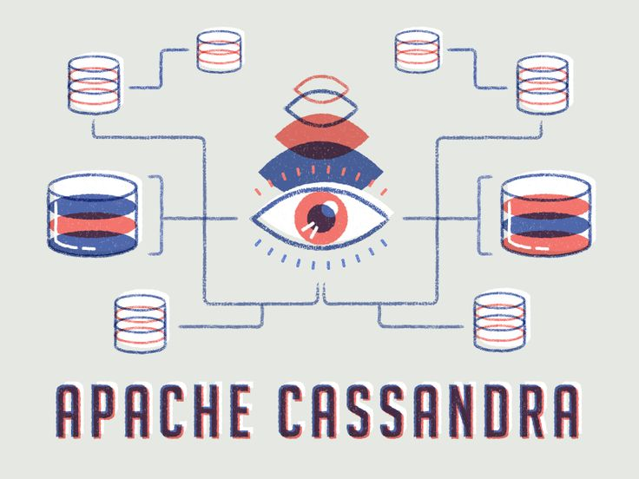
Distributed
Definition-a database that is not limited to one system and is spread over different sites, i.e., on multiple computers or over a network of computers

Slide 8

Database Security
Database security refers to the range of tools, controls, and measures designed to establish and preserve database confidentiality, integrity, and availability.

Slide 9
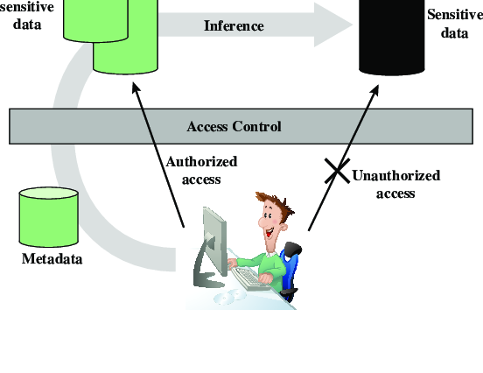
Inference & Aggregation
Inference
A database technique used to attack databases where malicious users infer sensitive information from complex databases at a high level.
Aggregation
The process by which entities are combined to form a single meaningful entity

Slide 10

Injections & Data Corruption
Injections
A cyberattack that injects malicious SQL code into an application, allowing the attacker to view or modify a database.
Data Corruption
Errors in computer data that occur during writing, reading, storage, transmission, or processing, which introduce unintended changes to the original data.

Slide 11

Unauthorized Access & Hashing and Encryption
Unauthorized Access
A person gains physical access without permission to a network, system, application, data, or other resources.
Hashing and Encryption
Hashing data is mapped to a fixed-length
Encryption information is scrambled in such a way that it can be unscrambled later.

Slide 12
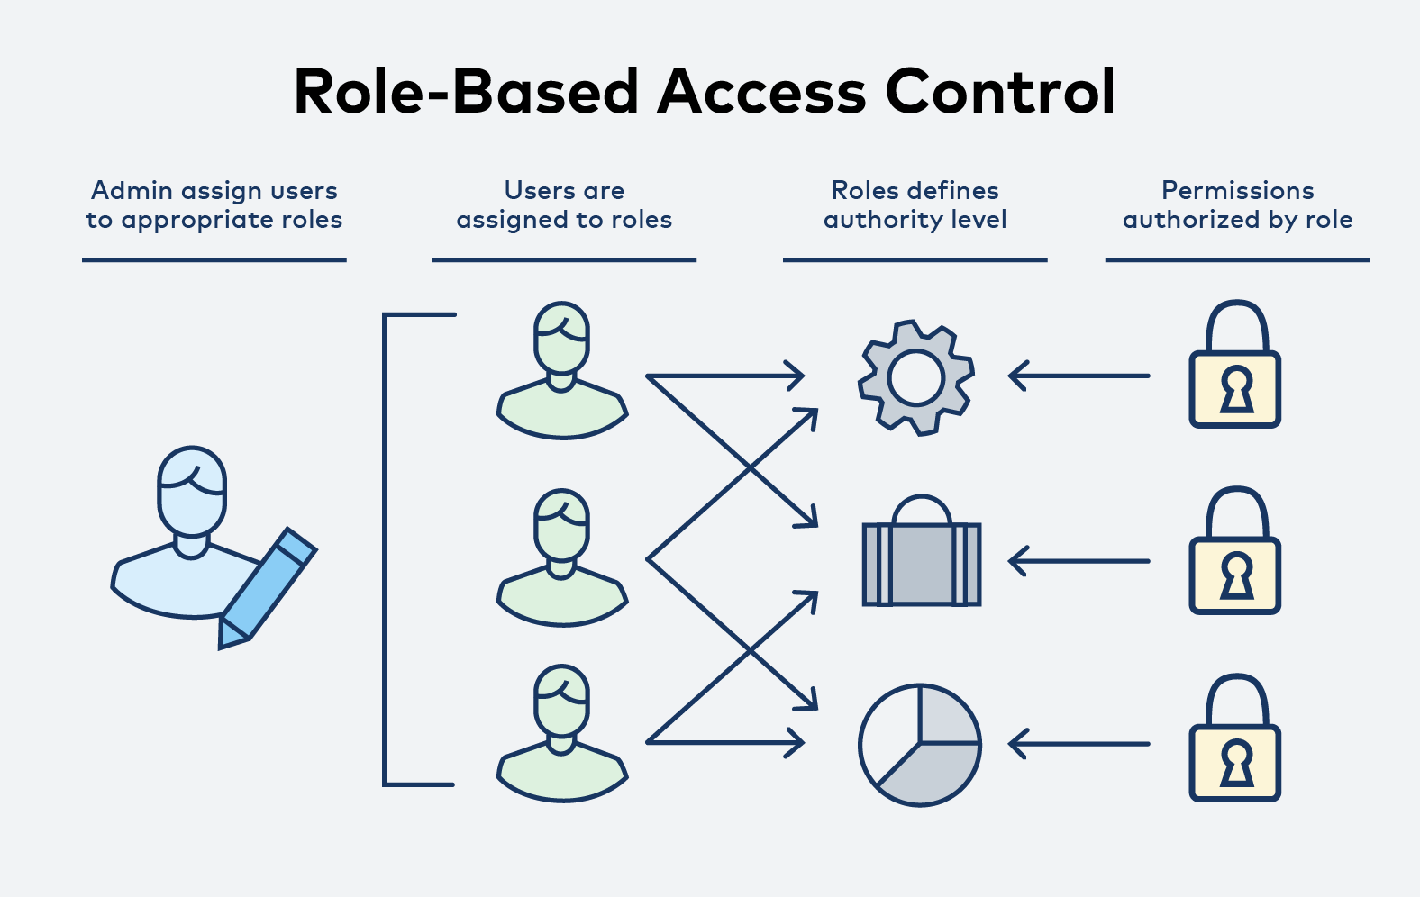
Database Access Controls
DAC
a method for assigning access rights based on rules defined by the user.
MAC
a policy that assigns access permissions based on central authority regulations.
RBAC
uses fundamental security principles like “least privilege” and “separation of privilege” to give access depending on a user’s role.
Clark-Wilson
an integrity, application-level model which attempts to ensure the integrity properties of commercial data and provides a framework for evaluating security in commercial application systems.

Slide 13
References
Database Security: An Essential Guide | IBM. www.ibm.com/topics/database-security.
GeeksforGeeks. “Distributed Database System.” GeeksforGeeks, 4 Mar. 2023, www.geeksforgeeks.org/distributed-database-system.
---. “Hierarchical Model in DBMS.” GeeksforGeeks, 7 July 2021, www.geeksforgeeks.org/hierarchical-model-in-dbms.
---. “Object Based Databases.” GeeksforGeeks, 23 Feb. 2022, www.geeksforgeeks.org/object-based-databases.
Satori Cyber. “Access Control 101: A Comprehensive Guide to Database Access Control - Satori.” Satori, 10 Aug. 2022, satoricyber.com/access-control/access-control-101-a-comprehensive-guide-to-database-access-control/#:~:text=Database%20access%20control%2C%20or%20DB%20access%20control%2C%20is,persons%20to%20prevent%20data%20breaches%20in%20database%20systems.

